Slide 1
“CAUSE OF DEATH”
PRESENTED BY
Prakash kumar sinha

Slide 2

Introduction
Data set
EDA
Visualisation
Conclusion

Slide 3
Introduction
A straightforward way to assess the health status of a population is to focus on mortality – or concepts like child mortality or life expectancy, which are based on mortality estimates.
. Assessing health outcomes by both mortality and morbidity (the prevalent diseases) provides a more encompassing view on health outcomes. This is the topic of this entry. The sum of mortality and morbidity is referred to as the ‘burden of disease’ and can be measured by a metric called ‘Disability Adjusted Life Years‘ (DALYs). DALYs are measuring lost health and are a standardized metric that allow for direct comparisons of disease burdens of different diseases across countries, between different populations, and over time.

Slide 4
Intro…
The first ‘Global Burden of Disease’ (GBD) was GBD 1990 and the DALY metric was prominently featured in the World Bank’s 1993 World Development Report. Today it is published by both the researchers at the Institute of Health Metrics and Evaluation (IHME) and the ‘Disease Burden Unit’ at the World Health Organization (WHO), which was created in 1998. The IHME continues the work that was started in the early 1990s and publishes the Global Burden of Disease study

Slide 5
Dataset
In this Dataset, we have Historical Data of different cause of deaths for all ages around the World. The key features of this Dataset are: Meningitis, Alzheimer's Disease and Other Dementias, Parkinson's Disease, Nutritional Deficiencies, Malaria, Drowning, Interpersonal Violence, Maternal Disorders, HIV/AIDS, Drug Use Disorders, Tuberculosis, Cardiovascular Diseases, Lower Respiratory Infections, Neonatal Disorders, Alcohol Use Disorders, Self-harm, Exposure to Forces of Nature, Diarrheal Diseases, Environmental Heat and Cold Exposure, Neoplasms, Conflict and Terrorism, Diabetes Mellitus, Chronic Kidney Disease, Poisonings, Protein-Energy Malnutrition, Road Injuries, Chronic Respiratory Diseases, Cirrhosis and Other Chronic Liver Diseases, Digestive Diseases, Fire, Heat, and Hot Substances, Acute Hepatitis.

Slide 6

EDA
Analysis :
Importing Libraries

Slide 7
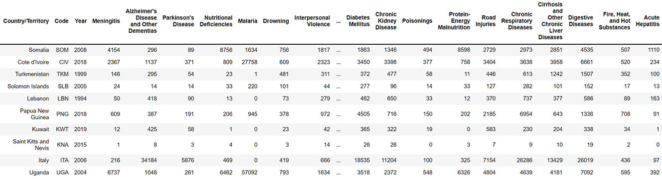
Structure of dataset
Data set having 6120 rows and 34 columns

Slide 8
. Columns name of data set
['Country/Territory', 'Code', 'Year', 'Meningitis', 'Alzheimer's Disease and Other Dementias', 'Parkinson's Disease', 'Nutritional Deficiencies', 'Malaria', 'Drowning', 'Interpersonal Violence', 'Maternal Disorders', 'HIV/AIDS','Drug Use Disorders', 'Tuberculosis', 'Cardiovascular Diseases','Lower Respiratory Infections', 'Neonatal Disorders‘, 'Alcohol Use Disorders', 'Self-harm', 'Exposure to Forces of Nature', 'Diarrheal Diseases', 'Environmental Heat and Cold Exposure', 'Neoplasms', 'Conflict and Terrorism', 'Diabetes Mellitus', 'Chronic Kidney Disease', 'Poisonings', 'Protein-Energy Malnutrition‘, 'Road Injuries', 'Chronic Respiratory Diseases', 'Cirrhosis and Other Chronic Liver Diseases', 'Digestive Diseases', 'Fire, Heat, and Hot Substances', 'Acute Hepatitis'],
There is no null values present in the data set
Out of 34 columns , 32 columns are of int64 type and only two ['Country/Territory', 'Code']
are of object type.

Slide 9
I want to take a look at the total global deaths and which countries lead in total deaths.
This requires aggregating across the DataFrame so we'll need to drop the 'Year' column.
Total Global Deaths from 1990-2019
Let's make a new column called 'Total Deaths'.
Total death
Total global deaths from 1990-2019:--- 1,468,134,716

Slide 10
Visualisation

Slide 11
TOP 10 COUNTRIES WITH THE MOST DEATHS FROM 1990-2019
1 | CHINA | 265408106.0
2 | INDIA | 238158165.0
3 | UNITED STATE | 71197802.0
4 | RUSSIA | 59591155.0
5 | INDONESIA | 44046941.0
6 | NIGERIA | 43670014.0
7 | PAKISTAN | 38151878.0
8 | BRAZIL | 32674112.0
9 | JAPAN | 31922807.0
10 | GERMANY | 25559667.0

Slide 12
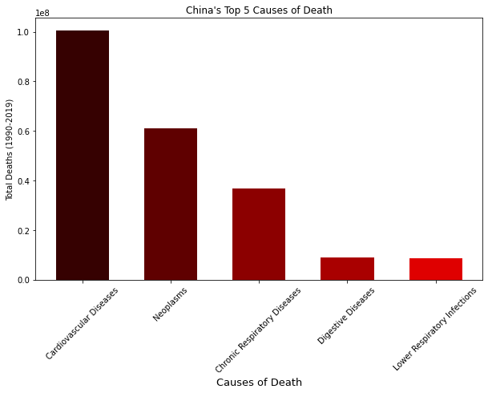
CHINA
Top 5 cause of death in china –
Cardiovascular Disease
Neoplasm
Chronic respiratory disease
Digestive disease
Lower respiratory infection

Slide 13
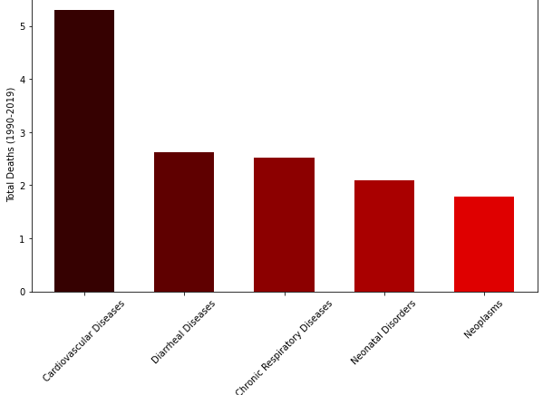
INDIA
Top 5 cause of death in India –
Cardiovascular Disease
Diarrheal disease
Cronic respiratory disease
Neonatal disorders
Neoplasms

Slide 14
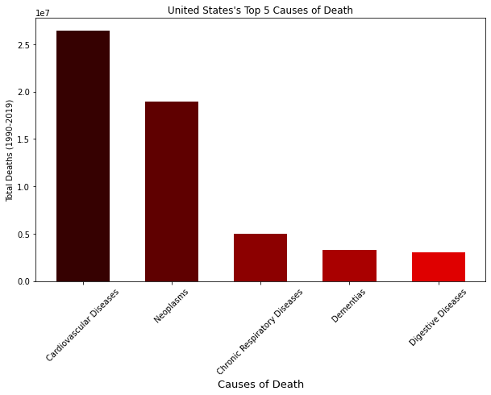
USA
Top 5 cause of death in United states – Cardiovascular Disease Neoplasm
Chronic respiratory disease
Dementias
Digestive disease

Slide 15
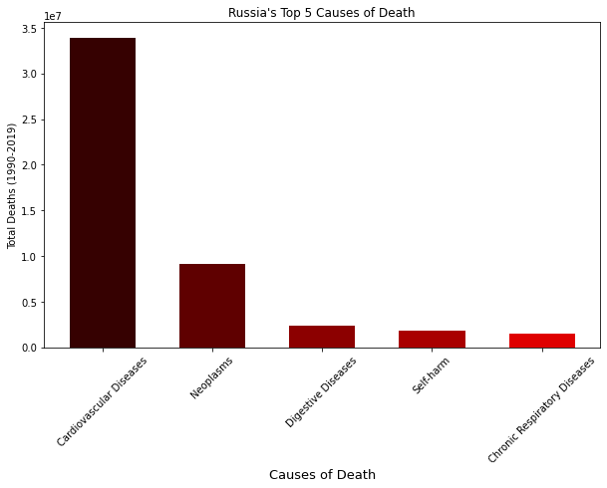
RUSSIA
Top 5 cause of death in Russia –
Cardiovascular Disease
Neoplasm
Digestive disease
Self harm
Chronic respiratory disease

Slide 16
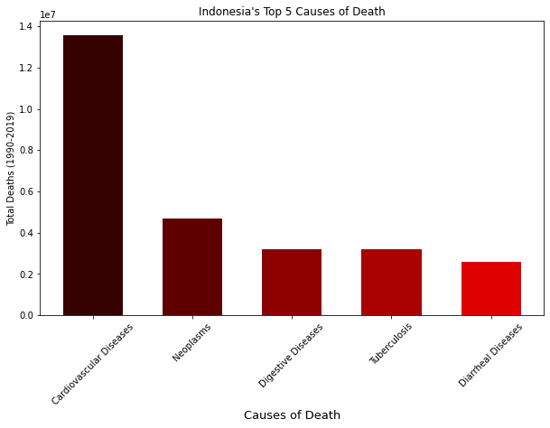
INDONESIA
Top 5 cause of death in Indonesia – Cardiovascular Disease Neoplasm
Digestive disease
Tuberculosis
Diarrheal disease

Slide 17
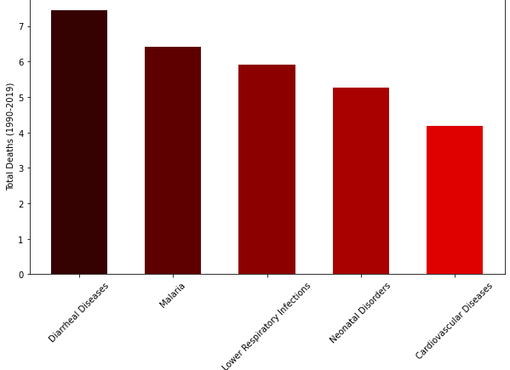
NIGERIA
Top 5 cause of death in Nigeria –
Diarrheal disease
Malaria Lower respiratory infection
Neonatal disorder
Cardio vascular disease

Slide 18
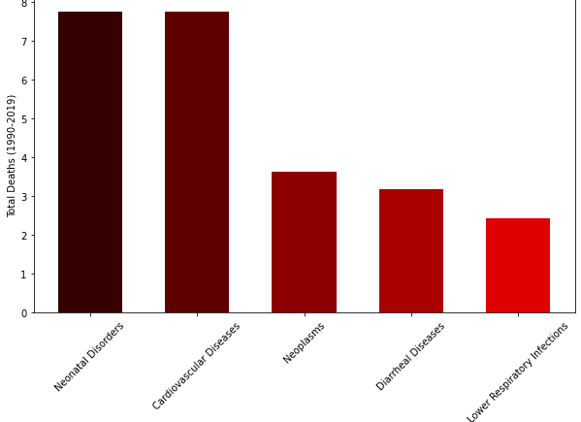
PAKISTAN
Top 5 cause of death in Pakistan –
Neonatal disorder
Cardio vascular disease
Neoplasm
Diarrheal disease Lower respiratory infection

Slide 19
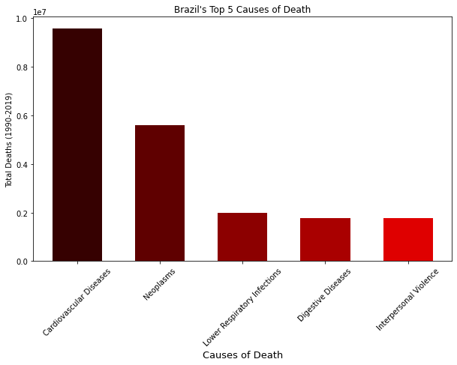
BRAZIL
Top 5 cause of death in Brazil–
Cardio vascular disease
Neoplasm
Lower respiratory infection
Digestive disease
Interpersonal violence

Slide 20
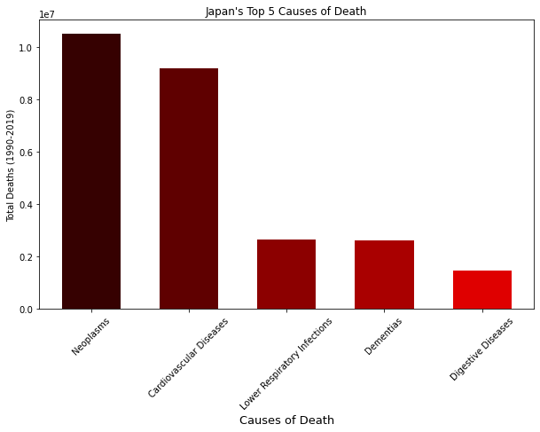
JAPAN
Top 5 cause of death in Japan–
Neoplasm
Cardio vascular disease
Lower respiratory infection
Dementias
Digestive disease

Slide 21
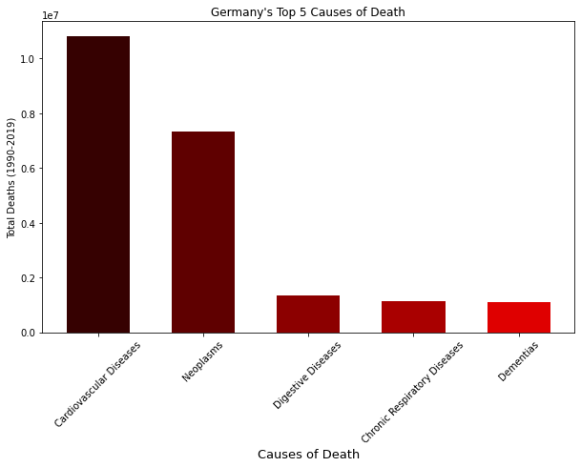
GERMANY
Top 5 cause of death in Germany–
Cardio vascular disease
Neoplasm
Digestive disease
Cronic Respiratory disease
Dementias

Slide 22
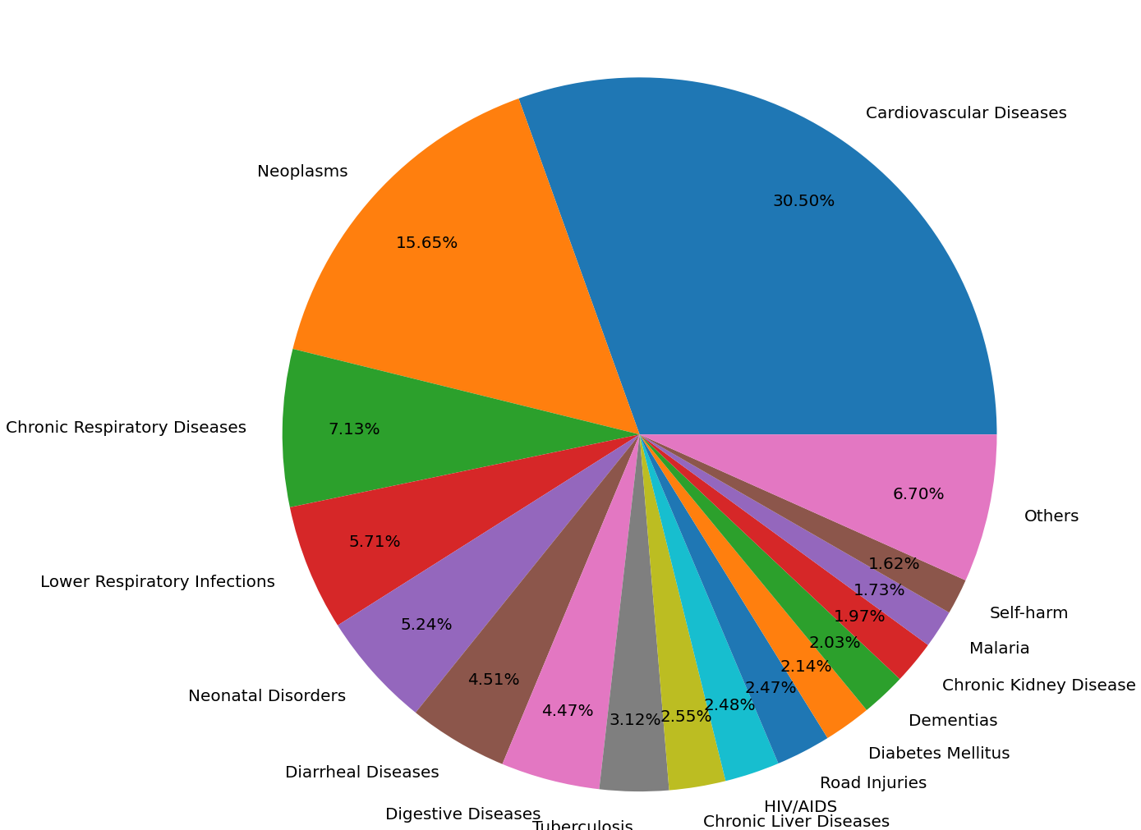
NOW TOP 5 REASONS BEHIND DEATH IN THE WORLD ARE
Cardio vascular disease (30.5%)
Neoplasm (15.65%)
Chronic Respiratory disease (7.13%)
Lower respiratory infection (5.71%)
Neonatal disorders (5.24%)

Slide 23
NOW TOP 5 FAVORABLE COUNTRIES FOR THE TOP 5 KILLERS

Slide 24
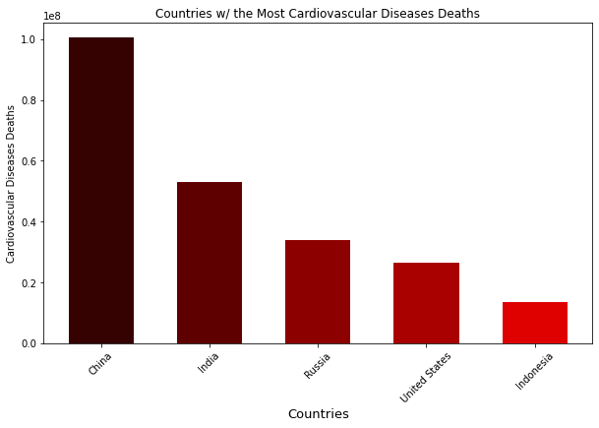
CARDIO VASCULAR DISEASE (30.5%)
China is the country where Cardiovascular disease occurred highest followed by India

Slide 25
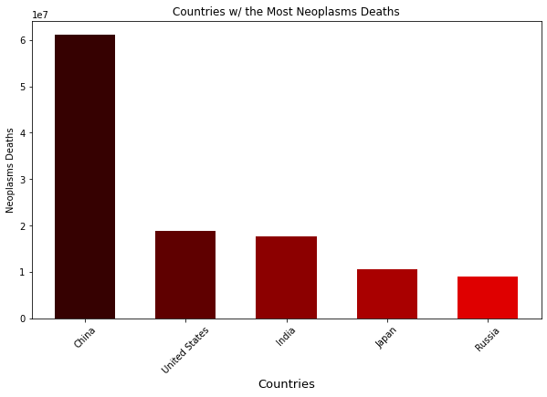
NEOPLASM (15.65%)
China is the country where Neoplasm occurred highest followed by United states and India

Slide 26
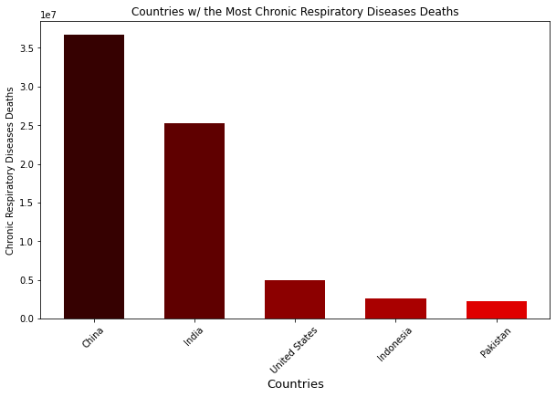
CHRONIC RESPIRATORY DISEASE (7.13%)
China is the country where Chronic Respiratory disease occurred highest followed by India

Slide 27
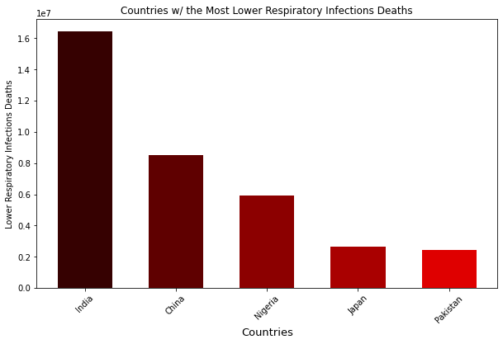
LOWER RESPIRATORY INFECTION (5.71%)
India is the country where Lower Respiratory infections occurred highest followed by China

Slide 28
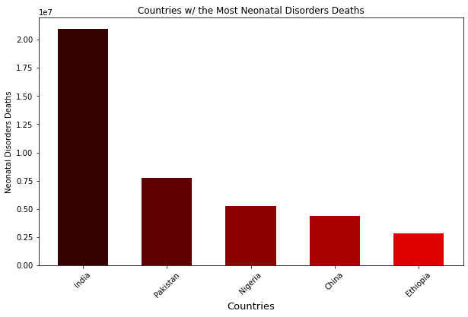
NEONATAL DISORDERS (5.24%)
India is the country where Neonatal disorder occurred highest followed by Pakistan.

Slide 29
Conclusion-
China, India and USA face the largest brunt of deaths due to disease in the world Cardiovascular disease, Neoplasm, and lower respiratory Tract infection . As these are the top killers in the world.

Slide 30
Thank you

